Slide 1


Strategies for Sustainable Development: The Role of Renewable Resource Management System
Welcome to our presentation on sustainable development and the importance of renewable resource management. Together, let's explore strategies for a greener future.

Slide 2

Introduction to Sustainable Development
Sustainable development seeks to meet the needs of the present without compromising the ability of future generations to meet their own needs. It encompasses economic, social, and environmental aspects.

Slide 3
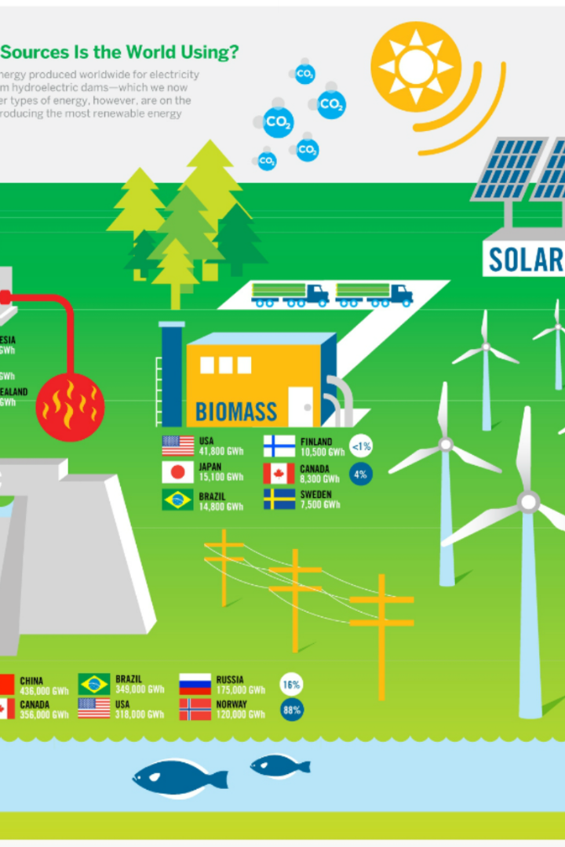
Overview of Renewable Resource Management
Renewable resource management focuses on harnessing renewable sources of energy and maximizing their efficiency. It involves practices such as wind farm installations, solar power generation, and efficient waste management systems.

Slide 4

Benefits of Implementing a Renewable Resource Management System
1
Environmental Preservation 🌿
Reduced carbon footprint, improved air and water quality, and preservation of natural resources for future generations.
2
Economic Advantages 💰
Job creation, increased energy independence, and long-term cost savings compared to traditional energy sources.
3
Social Impact 🤝
Enhanced community resilience, improved public health, and greater energy equity for everyone.

Slide 5
Key Components of a Renewable Resource Management System
Energy Generation
Energy Storage
Policy and Regulation
Investing in renewable energy infrastructure
Implementing efficient energy storage solutions
Enacting supportive policies and regulations
Optimizing energy production through clean technologies
Developing smart grid systems for better energy management
Incentivizing renewable energy adoption

Slide 6

Challenges and Obstacles in Adopting Renewable Resource Management
1
Technological Limitations
Developing new innovations and improving existing technologies to enhance efficiency and overcome geographical constraints.
2
Transition Costs
Managing initial investments and ensuring a smooth transition from traditional energy systems to renewable alternatives.
3
Policy and Regulatory Barriers
Addressing policy gaps and fostering collaboration between governments and stakeholders to create an enabling environment.

Slide 7
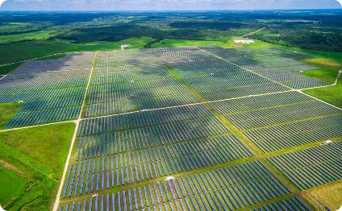

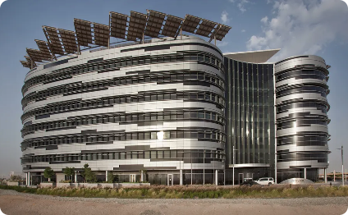
Case Studies and Examples of Successful Renewable Resource Management Systems
Solar Farms
Wind Farms
Energy-Efficient Buildings
Large-scale solar farms power communities with clean energy while creating local job opportunities.
Strategically located wind farms generate electricity using wind turbines, reducing reliance on fossil fuels.
Utilizing sustainable building practices and energy-saving technologies for reduced environmental impact.

Slide 8

Conclusion and the Future of Sustainable Development
By embracing renewable resource management, we can pave the way for a sustainable and prosperous future. Together, let's create a world powered by clean and renewable energy sources.

